Slide 1
wxAstroCapture
Manual and How To …
V 0.4
20091128/BM/CA
Note: All mentioned trademarks and names owned by third party are mentioned for clear identification only.

Slide 2
Content
What it is …
  Features and Functions
  Supported Environments
  Supported Capture Devices
  Supported IO Devices
  Output Formats
Basic User Interface
  The Menu Bar
  The Tool Bar
  The Status Line
  The Preview Area
  Using Sub Frames
Connecting a Camera
  Properties of a Camera
  Web Cam Properties
Capturing Images
  Web Cam Exposures
More on Feature Tabs
  The complete Rec Feature Tab
  Guide to Guiding
  Batch Jobs
… Cont’d
Options – Settings
  Video Capture
  Container & File Names
  LE Control Port
  Guiding Port (also in Guiding)
Options – Guiding
  Calibration
  Interface
  Guide Port (also in Settings)
Options – FITS Header
Tips & Tricks
References & Links
new
new

Slide 3
What it is …
Program to capture images from a variety of cameras
Intended field of use – amateur astronomy
Runs on Linux and Win computers
Free to use (but not Open Source)
Created and maintained by two guys from Norway and Switzerland
Supporting group: http://tech.groups.yahoo.com/group/wxAstroCapture/

Slide 4
Features and Functions
Preview image stream
Preview long exposure image stream
Capture images from the stream into a variety of supported formats
Guide a telescope mount through parallel or serial ports
Guide calibration support
Access to guiding control parameters
LRGB Histogram of the video stream
Supports a variety of image storage options
Supports a variety of FITS keywords
Time stamping of captured images
Zoom and pan of the preview stream
Define and capture sub frames
Supports properties of webcams – save and load property profiles
Supports binning of Art/ATIK cameras
Batch processing of image capture jobs
Preview Recticle

Slide 5
Supported Environments
MS Windows:
  Win XP SP2 and SP3
  Win Vista 32bit and 64bit
Linux:
  Kubuntu 8.04, 8.10, 9.10 32bit and 64bit builds
  OpenSUSE Linux 10.3, 11.1 32bit and 64bit builds
  Deb and RPM packages may run on other distributions

Slide 6
Supported Capture Devices
Webcams:
  Philips Vesta and ToUCam CCD cameras
  Similar SAA8116 chip based cameras from Logitech and other manufacturers
  Long Exposure modified web cameras
  On Win capture devices supporting the WDM driver model may work
  On Linux capture devices hooking into the PWC or UVC driver may work
Artemis / ATIK:
  Artemis Model 285/429 and similar ATIK models
  ATIK 16IC.. (hopefully will work at some point in time, but not yet)

Slide 7
Supported IO Devices
Long Exposure IO Port
  Parallel port (original port – not trough USB)
    Configurable for Frame1/2, Shutter, Amp
  Serial port (original and various USB models)
    Configurable RTS and DTR for Frame and Amp
  Shoestring LXUSB
Guiding IO Port
  Parallel port (original port – not trough USB)
    Configurable for ST4 style interface – 4 signals
  Serial port RS232 - protocols for various mounts
  Shoestring GPUSB

Slide 8
Output Formats
AVI Video
  Uncompressed video stream
    YUV 4:2:2 – YUV2, YUYV, YVYU, UYVY
    YUV 4:2:0 – I420, YUI2, IYUV
    RGB24 – RGB bitmap stream (for webcam capturing)
FITS image format
  16 bit FITS image
    1 plane (BW)
    3 planes (RGB)
Note: the individual format depends on the capture device – in general the format with the least compression is used

Slide 9
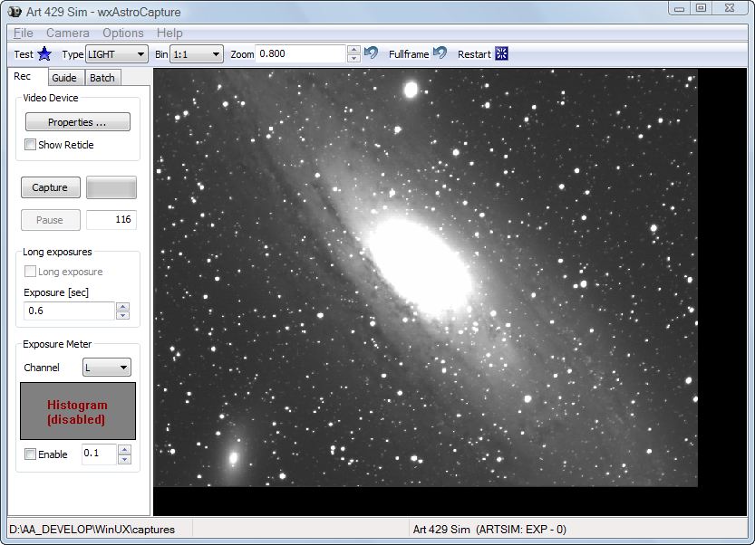
Basic User Interface
Menu Bar
Preview Area
Tool Bar
Feature Tabs
Feature Area
Status Line

Slide 10
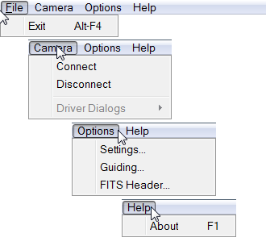
The Menu Bar
Leave wxAstroCapture
Connect a camera
Disconnect the camera
Open the Settings Window
Open the Guiding Window
Open the FITS Window
Show the About Box

Slide 11
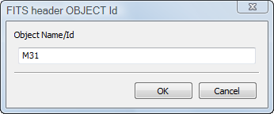


The Tool Bar
Define the FITS keyword ‘OBJECT’
Reset sub frame to full frame
Restart exposure cycle
Reset Zoom to 1.0
Define the preview zoom level (Scroll wheel)
Set the binning for Art/ATIK cameras
Define the type of exposure (FITS keyword)

Slide 12
The Status Line
Folder where images are captured
The currently active camera
Video Driver
LX when long exposing
Capture status
Remaining expo time (sec)
Number of frames
Accumulated expo time
Recording indication

Slide 13
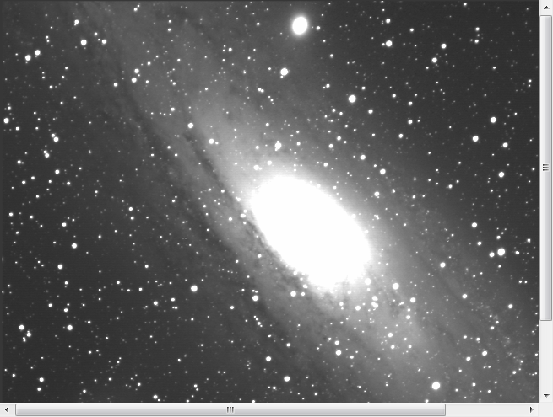
The Preview Area
Scroll bar
Click into the preview area and then use the scroll wheel to zoom in and out
If the image gets larger scroll bars help to navigate
Left click and drag to move the image around

Slide 14
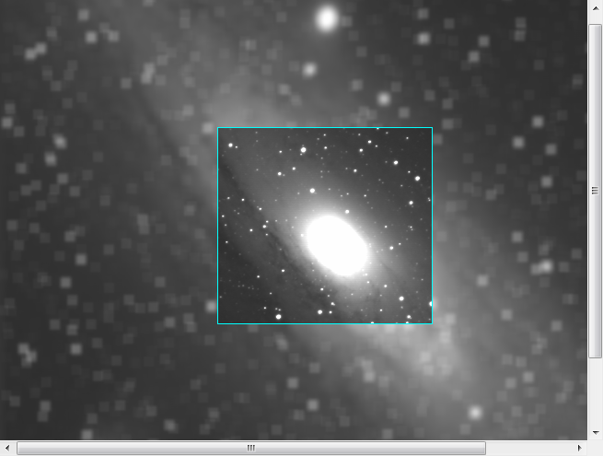
Using Sub Frames
Active sub frame
Inactive area (blurred)
Click into the preview area then right click and drag the green preview rectangle to the desired size and position
Release the mouse
The chosen sub frame gets a blue frame and the inactive part of the image gets blurred
Note: sometimes it needs a second attempt to get it working, with long exposure or Art/ATIK cameras the sub frame will only appear after the next capture cycle – so be patient and try a bit around

Slide 15
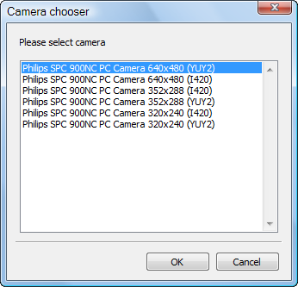
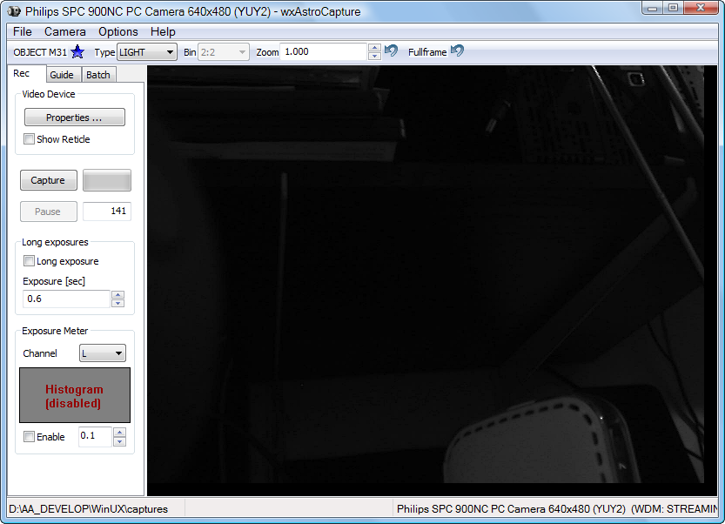
Connecting a Camera
3. Chose one of the entries
4. Either click OK
Or double click the entry
1. Use the Camera menu
2. Then Connect
5. You should see an image now

Slide 16
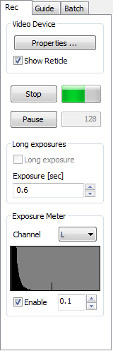
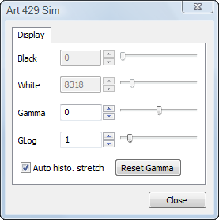
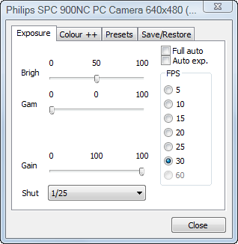
Properties of the camera
The Rec Feature Tab
Art/ATIK Properties
Black level (if Auto is off)
White level (if Auto is off)
Gamma level (-10 .. +10)
GammaLog level (0 .. +10)
Reset Gamma to zero level
Webcam Properties
See next page …

Slide 17
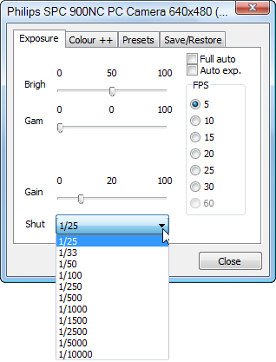
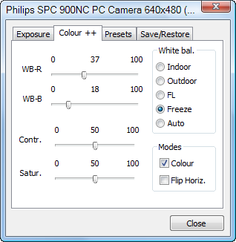
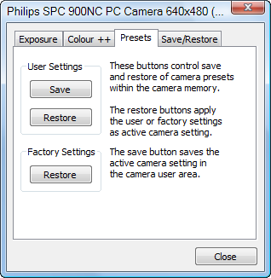
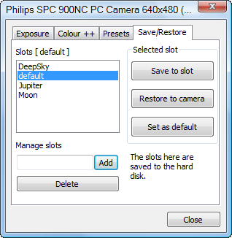
Web Cam Properties
4 Tabs here: Exposure; Colour, Presets, Save/Restore
To be used at discretion
Save/Restore provides ‘Slots’ to store favorite settings
- To create a new Slot first type a name then click Add
- Use it by selecting one then Save to or Restore from Slot
- Select one and make it default so it is loaded when the camera connects
Note: Presets are saved with the camera name
i.e. the one that shows up when connecting

Slide 18
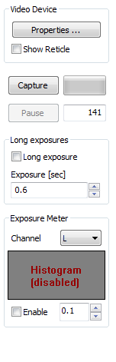
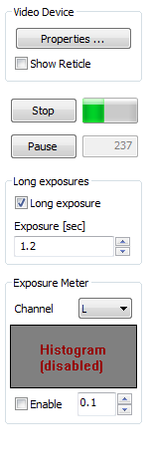
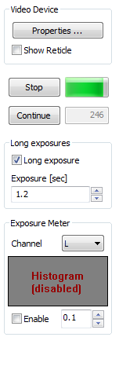
Capturing Images
Click Capture to start recording
Either Stop
or Pause recording
From Pause – Resume or Stop
Note: The image counter can be changed only when not recording

Slide 19

Web Cam Exposures
Web cams may be modified for long exposure (LE)
- The means to control long exposure are in ‘Options – Settings – LX-Port Control’
- Once properly setup check the box to run LE imaging
- The exposure time is set in the field (either type or click the spinner)
- Uncheck to retire the LE mode
The Status Line shows the remaining expo time
Here it is 34 seconds
Note: LX means Long Exposure here
Otherwise it reads ..:STREAMING
Note: WDM will be V4L2 when using Linux
It is the used driver (video4linux2)

Slide 20
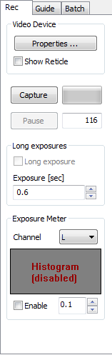
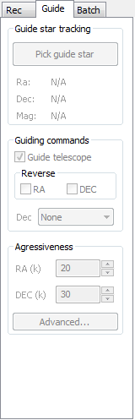
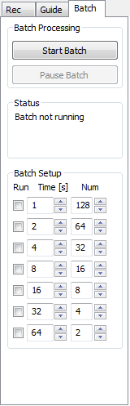
More on Feature Tabs
Rec:
Provides access to capture features
Guide:
Provides access to guiding features
Batch:
Contains the batch job items

Slide 21
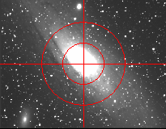

The complete Rec Feature Tab
Opens the camera Properties (the content depends on the camera type)
Switches the preview recticle on and off
Start and Stop capturing images to the disk
Capture activity indicator
Next image number (can be changed when not capturing)
Pause / Resume capturing (into the same store)
Switches long exposure on and off (only webcams)
Exposure time
Histogram channel chooser
Histogram display
Switches the histogram display on and off

Slide 22
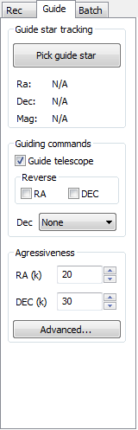
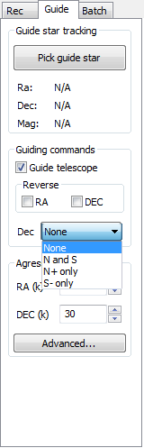
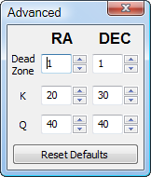
Guide to Guiding
Guiding starts with setting the guider interface in ‘Options – Guiding’ …
Once prepared click ‘Pick Guide Star’ and move the mouse into the preview area
- Click a bright star to define the guiding target
- Now the program calculates the delta an sends the guide commands
- Uncheck ‘Guide Telescope’ to rest guiding
- Check the RA / DEC boxes to reverse the direction of the commands
- It is possible to disable DEC guiding or guide in only a specified direction
- Guiding can be controlled by adjusting the aggressiveness
Aggressiveness and Advanced Parameters: Aggressiveness is how fast the telescope tries to compensate for measured tracking errors. The K and Q factors are used for computing the required RA and DEC compensating guide pulse lengths (in [ms]) from measured errors in arc seconds:
PulseLength_{RA} = K_{RA} * err_{RA} + Q_{RA}
PulseLength_{DEC} = K_{DEC}* err_{DEC} + Q_{DEC}
Q is the minimum pulse length and K is a scaling factor [ms/arcsec] causing longer guide pulses for larger errors. Larger values of K and Q will increase aggressiveness. Spend some time with these parameters to find the balance between a smooth behavior and fast response for your mount.
The “Dead Zone” indicates the minimum guiding error (in arc seconds) before any guiding will happen.

Slide 23
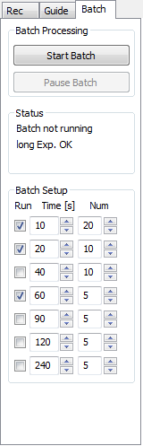
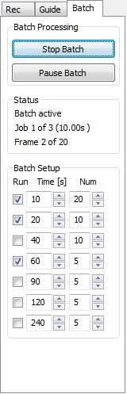
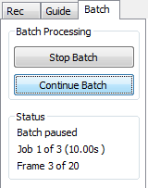
Batch Jobs
There are 7 batch entries that can be used
Each having an exposure time and a number of images to take
To define a particular batch – check or uncheck the entries you want to run
Then click ‘Start Batch’ and the exposure session will start
Pause and Resume allow to readjust the scope/camera if needed, Stop will stop… no resume here

Slide 24
Image Capture Basics
Image capturing or recording to the hard disk can be defined in some ways to achieve the most desired format for further processing.
The two basic types supported by wxAstroCapture is AVI stream and FITS image
AVI records images in one stream file and there each image with 8bit luminance depth – it is therefore only available with web cams. The AVI stream is left uncompressed.
AVI subtypes are RGB24 where a stream of bitmaps (Win BMP type) is recorded.
The second subtype is YUV where an Y-image is recorded with full resolution, the colour information is recorded into the U and V channels at a lower resolution.
FITS images are recorded with the Art/ATIK cameras (where AVI is not available) or for web cam recording of long exposure series.
FITS images can be recorded in folders or into a compressed ZIP file.
FITS images are recorded with 16bit depth per channel (note webcams will only give max 8bit data per channel).
FITS supports the use of standard ‘Keywords’ recording some parameters of the capture process. wxAstroCapture provides a selection of such keyword & editable values.
If YUV is set only the Y channel is recorded to FITS
If RGB is set colour information is recorded for web cams
EXAMPLE – FITS HEADER
SIMPLE = T
BITPIX = 16 /U_SHORT, # bits storing pix values
NAXIS = 2 /2d plane image
NAXIS = 3 /3x 2d planar rgb color image
NAXIS1 = 640 /# of pixels/row
NAXIS2 = 480 /# of rows (also # of scan lines)
BSCALE = 1.000000 /real = fits-value*BSCALE+BZERO
BZERO = 32768.00 /real = fits-value*BSCALE+BZERO
TIMESYS = 'UTC' /Time system used
SWCREATE= 'wxAstroCapture V 1.6-4'
DATE-OBS= '2009-09-27T13:10:30.121' /UTC of start exposure
EXPTIME = 0.2240000 /Total integration time (s)
FRAMENO = 141 /Frame sequence number
OBJECT = 'OBJECT M31' /Object of observation
IMAGETYP= 'LIGHT' /LIGHT, BIAS, FLAT or DARK
CAMSETUP= '77;49;..;50;..;0;1;0;3;36;17;0;1;0;0;19;0;0;0;0;'
END

Slide 25
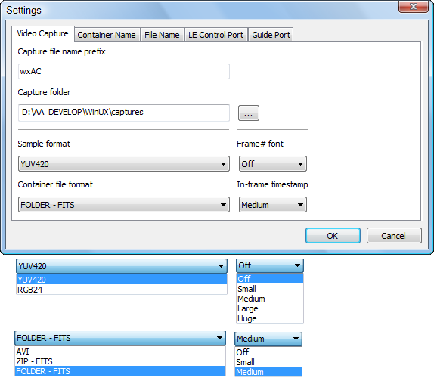
Options – Settings – 1
Video Capture
The ‘Prefix’ is used for filenames – see next
The ‘Capture folder’ defines where recording goes
‘Sample format’:
RGB24 records colour information as bitmap
YUV420 records in a variety of Luminance/Color formats depending on the camera, driver.
‘Frame# font’ define the size of the record counter shown in the preview while capturing.
‘Container file format’ The container concept is that whatever takes a bunch of images is a container.
So a container is either an AVI file, a ZIP file or a regular disk folder that takes one series of captured images.
‘In-frame timestamp’ If enabled then each image recorded is tagged with the millisecond UTC timestamp when the exposure started (based on the PC clock)
Images
Container

Slide 26
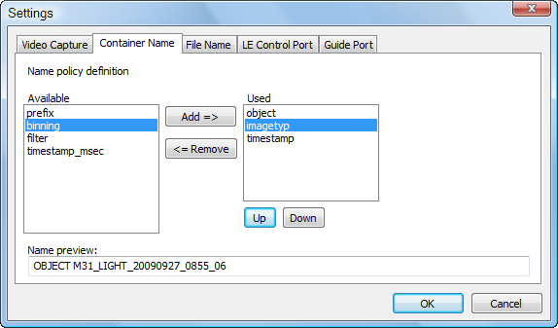
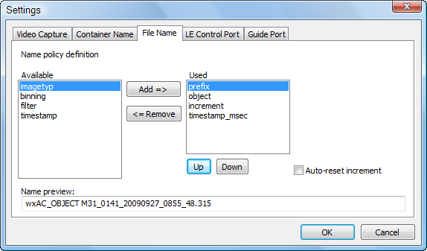
Options – Settings – 2
Container & File Names
As mentioned in 1) there is a container that will hold the images recorded for one capture session.
The ‘Container Name‘ (AVI or ZIP filename, or disk folder) can be composed from a variety of items known to the program.
Click on entry and ‘Add’ or ‘Remove’ it from the ‘Used’ section, click an entry in ‘Used’ and let it Up and Down move to define the sequence – the preview shows how it will look like in the end. One of the timestamps has to remain in ‘Used’ otherwise it would lead to ambiguity and overwritten files.
The same logic applies to the ‘File Name’ that is the name each file carries when recorded (AVI streams cannot not use this one as individual frames are not named)
Check ‘Auto-reset increment’ if the image counter should be reset for each capture session.

Slide 27
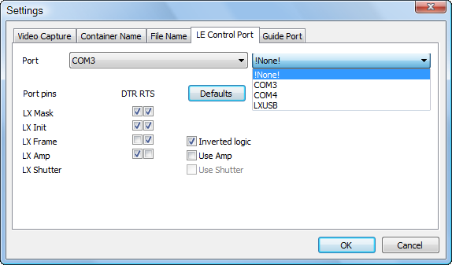
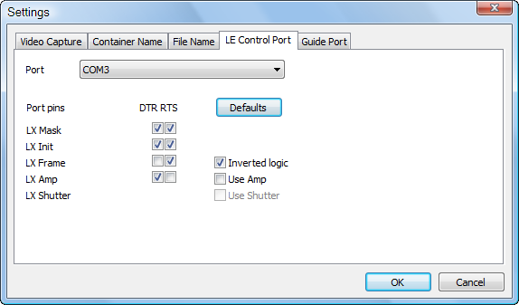
Options – Settings – 3
LE Control Port
Setting the port to control the long exposure (LE) for web cams.
Depending on the system none or various ports are available to chose as control port for LE.
Basic types are:
- Serial Port (RTS, DTR line)
- Parallel Port (chose from 8 pins)
- LXUSB Port (all set here)
‘Defaults‘ will always set the lines according to well known modifications – click this one if you don’t know.
Check ‘Use Amp’ if the amplifier mod is available.
Check ‘Use Shutter’ if the shutter line is wired on the parallel port (the program runs a shutter cycle to empty the CCD after each exposure)
‘Masking’ means that other lines are not touched and are available to e.g. guiding when using the parallel port. → So make sure only the used lines are masked otherwise strange things will happen…
Insert Parallel

Slide 28
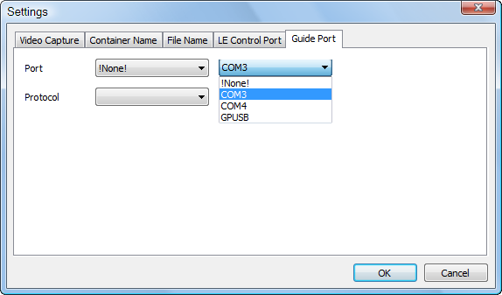
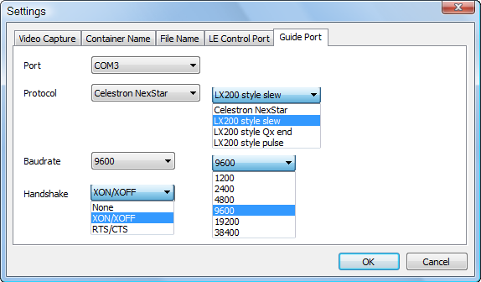
Options – Settings – 4
Guiding Port
Setting the port to where the guiding telescope is connected to. Also available in Options – Guiding.
Depending on the system none or various ports are available to chose as control port for LE.
Basic types are:
- Serial Port (Speed, Handshake)
- Parallel Port (chose from 8 pins)
- GPUSB Port (all set here)
‘Protocol’ some guiding protocols are at hand.
The parallel and the GPUSB ports only support a ST4 style 4 wire hardware guiding. Setup is similar to the LX parallel port setup (don’t forget the masking)
For the serial port there is:
- Celestron NexStar
- LX200 style with slewing commands with #Q as stop
- LX200 style with additional #Qx(wesn) stop command
- LX200 style with ‘undocumented’ pulse commands
Insert Parallel

Slide 29
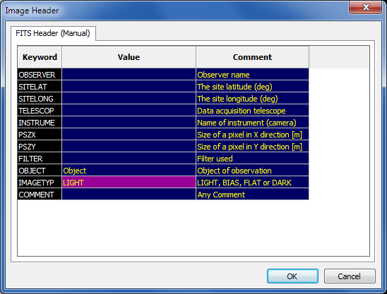
Options –
FITS Header
FITS images are recorded with the Art/ATIK cameras (where AVI is not available) or for web cam recording of long exposure series.
FITS supports the use of standard ‘Keywords’ recording some parameters of the capture process. wxAstroCapture provides a selection of such keyword & editable values.
Click into the Value or Comment Column and type the information that should be saved in the FITS keyword section
Delete the text to omit recording
Click OK to save and close – otherwise cancel to discard all edits

Slide 30
Tips & Tricks
to be done...

Slide 31
References & Links
References starting next page
  Stream Encoding
  …
Essential Links
  wxAstroCapture home
  http://arnholm.org/astro/software/wxAstroCapture
  wxAstroCapture Yahoo Group
  http://tech.groups.yahoo.com/group/wxAstroCapture/
  QCUIAG Yahoo Group
  http://tech.groups.yahoo.com/group/QCUIAG/
  S. Chambers (origin of WebCam mods)
  http://www.pmdo.com/wguide.htm
  Serial Cam Interface (S. Chambers)
  http://www.pmdo.com/images/serialconv.gif
  The WebCam Raw Modification
  http://www.astrosurf.com/astrobond/ebrawe.htm
  All about WebCams and much more (Jan)
  http://www.firmament.tk
  Scientific WebCams (Robin)
  http://www.threehillsobservatory.co.uk/
  Martin‘s pages
  http://www.burri-web.org/bm98/
  Win Parallel Port handling (Jan Axelson)
  http://www.lvr.com/parport.htm
  FourCC
  http://www.fourcc.org/
new
more to be done...

Slide 32
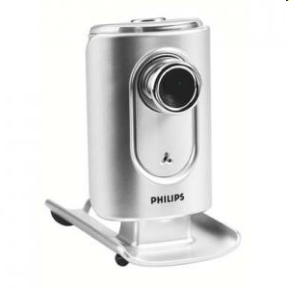
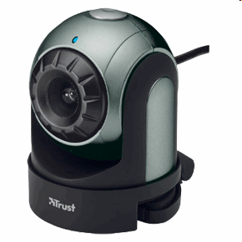
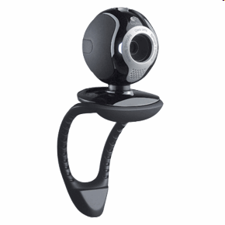
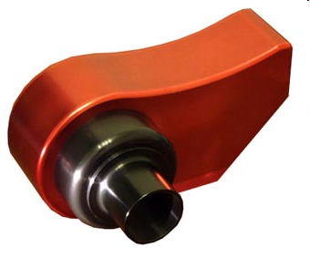
Reference –
Stream Encoding
CCD
I420
CamDriver
Native RGB selected
Live Image
CMOS
Camera
Selector
YUV (any)
To
RGB24
YUY2
RGB24
CamDriver
YUYV
RGB24
CamDriver
Size + Encoding
Native YUV selected
Sample Format *)
Note for WebCams:
No YUV if native was RGB !!!
YUV420
Art/ATIK
Y16
CamDriver
Container Format:
AVI or FITS Images
The driver may convert and therefore provide any
YUV or RGB format
depending on manufacturer and operating system
Art/ATIK has 16bit mono only
FITS
AVI
*) Sample Format and FITS:
YUV - only the Y channel is stored to FITS
RGB - colour information is stored for web cams
Operating system
Driver
Container
wxAstroCapture Program

